Slide 1
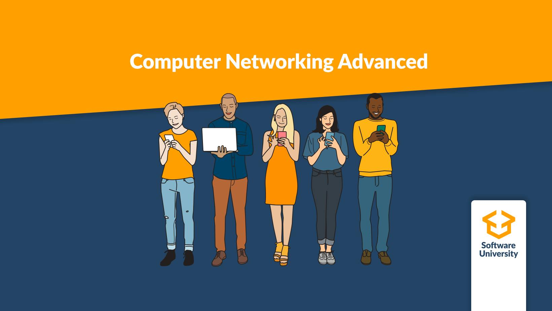
Computer Networking Advanced – course summary
Lecture 10
SoftUni Team
Technical Trainers
Software University
http://softuni.bg

Slide 2
Table of Contents
STP, link aggregation and stacking
OSPF advanced
ACL, NAT
DNS, IPv6
802.1x, Wireless concepts
QoS, Port mirroring
Virtualization and networking, VPN
SDN
Cloud networking with Microsoft Azure

Slide 3
Spanning Tree Protocol advanced (1)

Slide 4
The STP algorithm
Elect the Root switch (Root bridge)
This is the switch with the lowest BID (Bridge ID)
BID = Switch Priority and MAC
Select the root ports
They have the best cost (lowest) to the Root
Selected per switch
Select the designated ports
They have the best cost (lowest) to the Root
Selected per segment (connection)
All other ports go to blocking state

Slide 5
STP tie-breakers
If there is a tie situation - the same path cost via different paths, use the following tie-breakers:
When selecting Root port or Designated port, chose the neighboring switch which has the lowest Bridge ID
If the Bridge ID is the same, select the lowest Port ID (PID)
Port ID = Port priority and port number

Slide 6
Spanning Tree Protocol – Main Flavors
STP - Spanning Tree Protocol, IEEE 802.1D
RSTP - Rapid STP, IEEE 802.1W
MSTP - Multiple STP, IEEE 802.1S (802.1Q-2005)
PVST+ - Per-VLAN STP, Cisco proprietary

Slide 7
MSTP
Multiple Spanning Tree Protocol
Creates multiple instances of the physical STP topology
Can have different Root switches - one for each instance
Provides load-sharing because of the multiple Roots
It is also “rapid”
One instance is mapped to one or multiple VLANs
Needs additional configuration

Slide 8
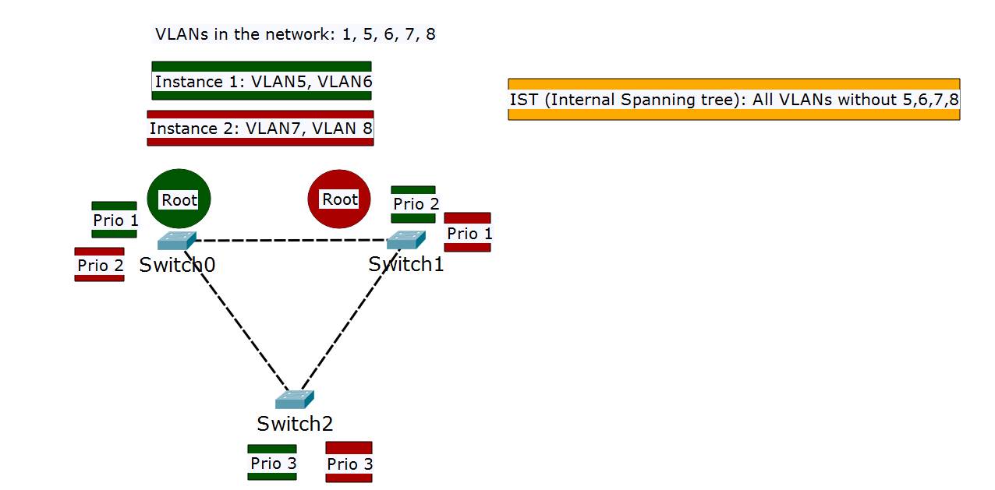
MSTP: multiple roots

Slide 9
MSTP configuration
All switches in the MSTP domain must be in the same region
Three parameters should be configured equally on all switches:
Configuration Name (region name)
Revision number
VLAN-to-instance mappings
The priorities are configured on a per instance basis

Slide 10
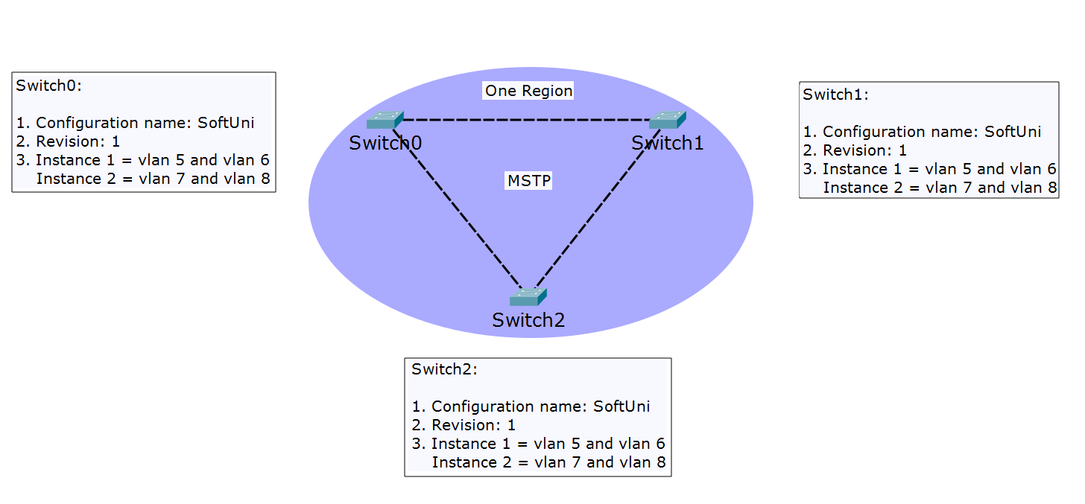
MSTP: all switches in the same region

Slide 11
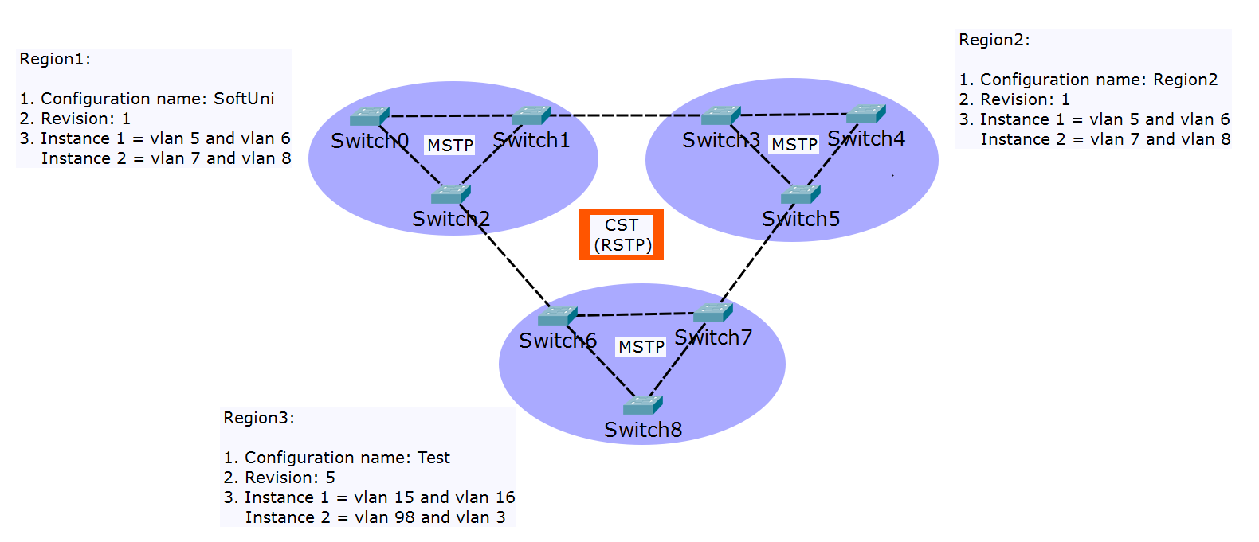
MSTP: multiple regions

Slide 12
MSTP vs PVST+
Two similar protocols, which one is better?
PVST+ advantages:
triggers STP calculation only if there is a potential loop in a particular VLAN
detailed “look” of the network – does not block ports when there is no loop on the trunks for a given VLAN
PVST+ disadvantages
generates a lot of overhead in the network
proprietary protocol

Slide 13
MSTP vs PVST+ (2)
MSTP advantages:
uses less BPDUs and generates less overhead
open standard
MSTP disadvantages:
not VLAN aware (does not look which VLANs are on the trunk ports)
Harder to configure
Recommendation: use MSTP if you have more than 100 VLANs

Slide 14
Link aggregation (1)

Slide 15
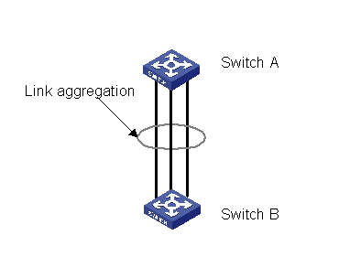
What is link aggregation?
Combination of two or more physical interfaces to create one logical link or port
Other terms with the same meaning:
Port trunking (HPE Provision)
EtherChannel (Cisco)
Link bundling
NIC bonding/teaming
Etc.

Slide 16
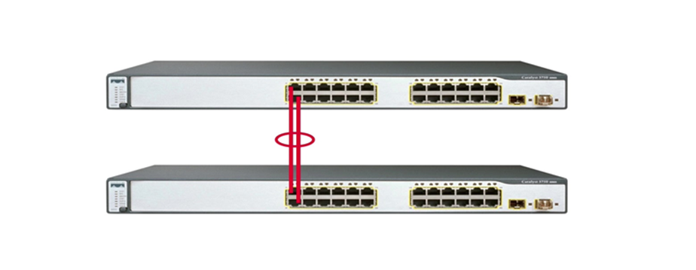
Why to use link aggregation?
To increase the bandwidth
To provide redundancy

Slide 17
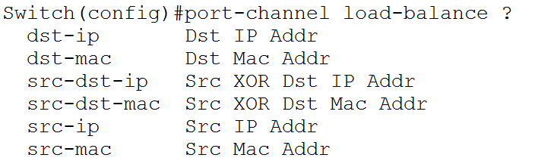
Load sharing modes
Multiple physical links form one logical but at the end the traffic uses the physical links
Which exact link to use - random decision based on the conversations
Conversations depend on the load sharing mode

Slide 18
Device stacking - IRF (1)

Slide 19
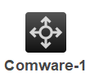
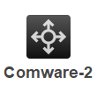
What is device stacking?
Combination of two or more physical devices to form one logical
One logical device

Slide 20
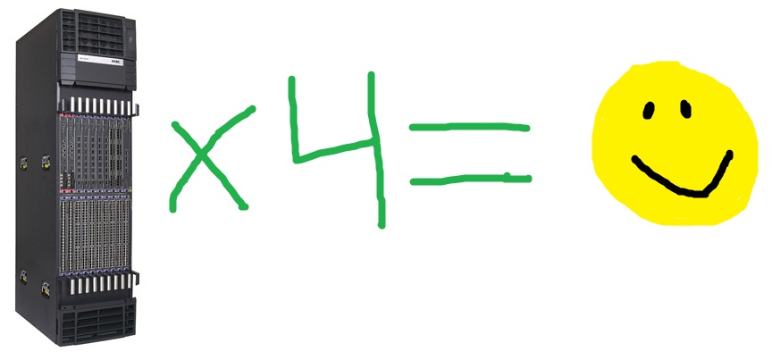
Why device stacking?
More resilient
Does not block ports (like STP)
Simple management
Simple design

Slide 21

IRF topologies
Daisy chain:
Ring:
SW-1
SW-2
SW-3

Slide 22
IRF ports and connections
Single physical cable Must be at least 10Gbps
SW-1
1/1
2/2
SW-2
x/y
IRF port – memberID/port
1/2
2/1
Only connect IRF port 1 to IRF port 2!
Possible connections | 1/1 -> 2/2 | 1/2 -> 2/1
Not possible connections | 1/1 -> 2/1 | 1/2 -> 2/2
3/1
3/2
SW-3

Slide 23
Master election
When creating the IRF stack:
The member with highest priority wins
If no member has a higher priority, the member with the longest system up-time wins (rounded to 10 minutes)
If no member has a longer up-time, the member with the lowest bridge MAC address wins
When joining another device to existing IRF stack:
The current master wins

Slide 24
IRF split stack
When there is a split stack situation, each of the two parts assumes “I am the new master”
This can create problems
Additional Multi Active Detection (MAD) algorithm needs to be configured:
LACP MAD
BFD MAD
ARP MAD

Slide 25
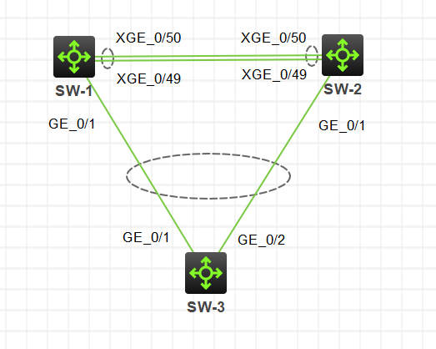
Detect IRF split stack with LACP MAD
I am the master!
I am the master!
Additional Comware switch is required
Extended LACPDU are exchanged
If split stack, MAD triggers election
Smaller member ID wins
The other device(s) put in recovery state (shuts down the ports)

Slide 26
OSPF advanced – general concepts (2)

Slide 27
OSPF terms
LSA – Link state advertisement
LSDB – Link state database
Router ID
Area
ABR – Area border router
Autonomous system
ASBR – Autonomous system boundary router

Slide 28
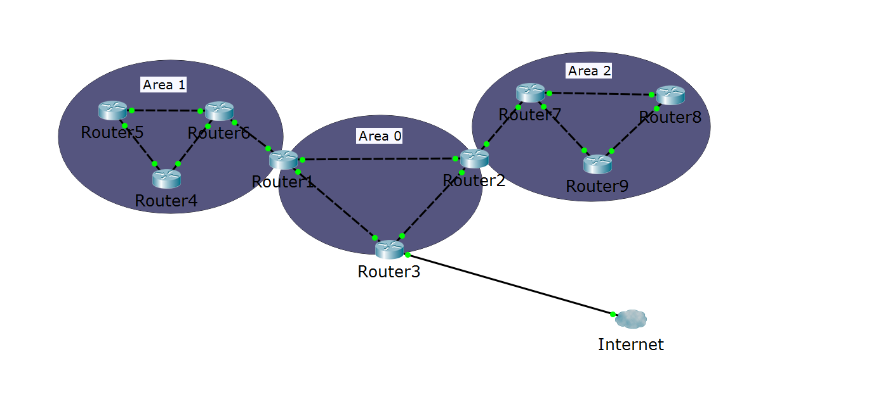
OSPF terms (2)
Autonomous system
ABR
ABR
ASBR
Area 0 = the backbone area

Slide 29
Neighbor relationships
If multiple routers are connected to a switch, we use designated router (DR) and backup designated router (BDR)
This minimizes LSA traffic
Other routers are referred to as DROTHER (DR other)
The DR and the BDR ensure that all routers receive all of the required updates

Slide 30
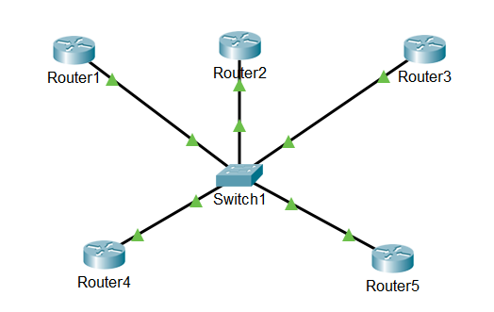
Neighbor relationships (2)
The DR, the BDR and the DROTHERs
DR
BDR
DROTHER
DROTHER
DROTHER

Slide 31
DR/BDR Election Process
The first router that is active on the link becomes the DR
The second router that is active on the link becomes the BDR
Link/interface priority is used for a re-election if the DR/BDR fails
Default priority is 1
Highest priority is elected; if a tie, the highest router ID (not IP address on the interface) is elected
A priority of 0 prevents a router from becoming a DR or BDR

Slide 32
OSPF advanced – multi area (2)

Slide 33
Why multiple areas?
When the OSPF domain is segmented to areas:
Inter-area routes can be summarized
Router’s LSDBs are not too big
The protocol is faster
Stability and control is increased

Slide 34
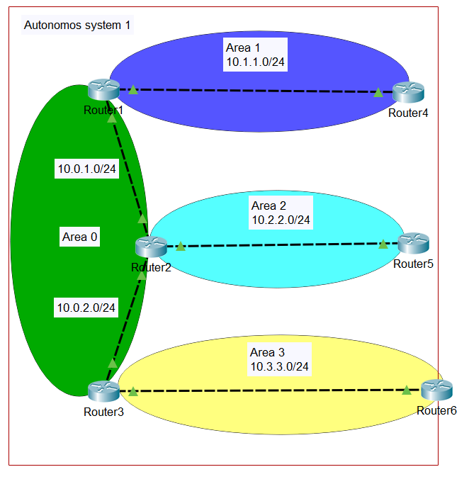
Multiple areas example
All other areas connect to Area 0 (the backbone area)
ABR routers in the example:
Router1
Router2
Router3

Slide 35
OSPF advanced – connect to external networks (2)

Slide 36
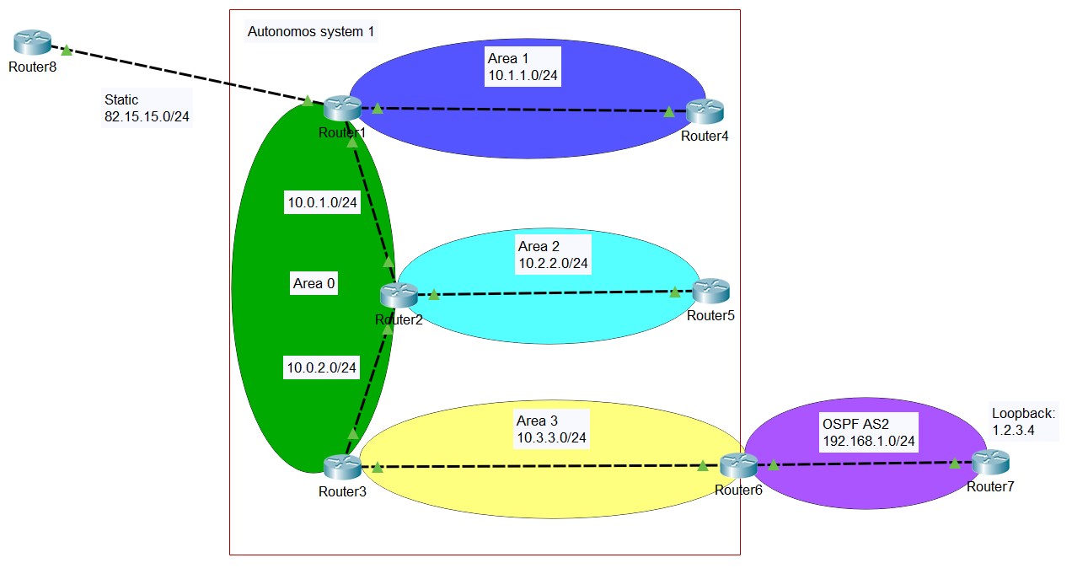
OSPF autonomous system and external networks
ASBR routers in the example:
Router1
Router6

Slide 37
Redistribute between protocols
You need to import or redistribute routes to your AS
Some options for redistribution:
redistribute RIP
redistribute ospf [process_id]
redistribute static
redistribute connected [subnets]

Slide 38
OSPF advanced – LSA and area types (2)

Slide 39
OSPF LSA types
LSA type 1: Router
LSA type 2: Network
LSA type 3: Summary
LSA type 4: ASBR summary
LSA type 5: ASBR external
LSA type 6: Multicast OSPF
LSA type 7: Not-so-stubby area LSA

Slide 40
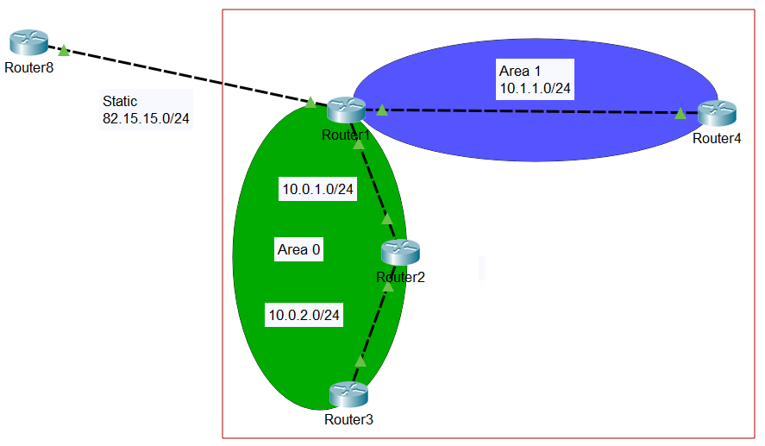
OSPF stub area
Uses LSA types 1, 2, 3 + default route (for external networks)
Blocks LSA types 4 and 5
Area 1 is stub.
Router1 injects:
Routes from area 0
Default route to externals

Slide 41
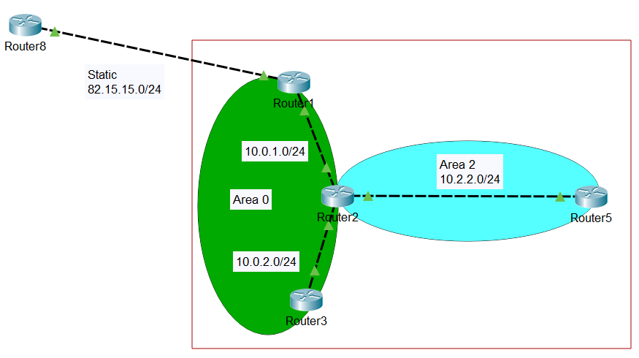
OSPF totally stubby area
Uses LSA types 1 and 2 + default route (for the other areas and external networks)
Blocks LSA types 3, 4 and 5
Area 2 is totally stubby. Router2 injects:
Default route to externals
(everything outside of Area 2)

Slide 42
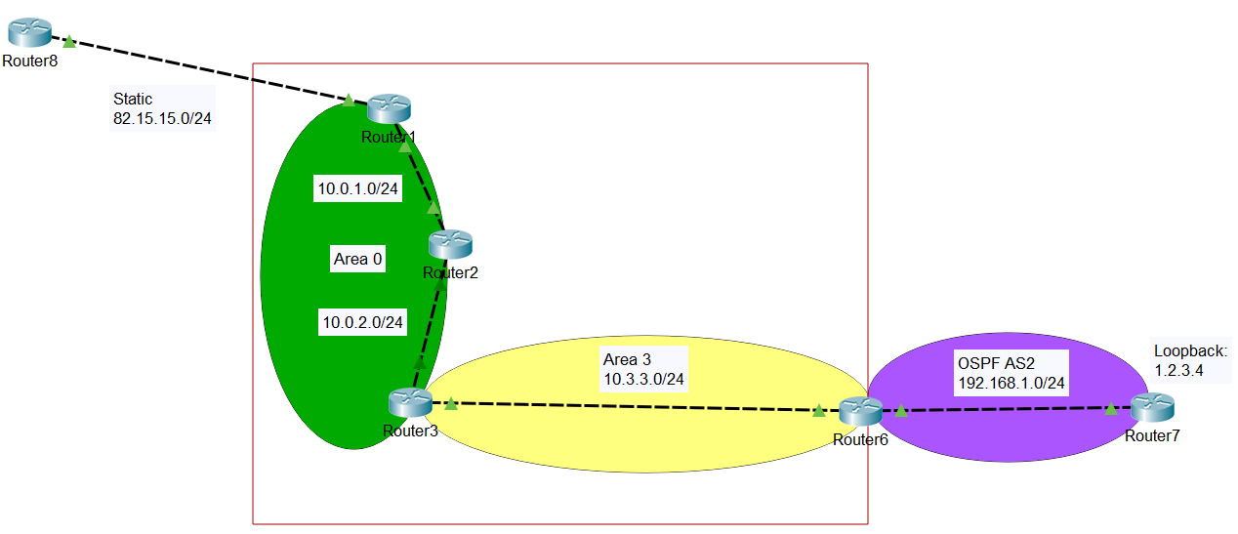
OSPF not-so-stubby area (NSSA)
Uses LSA types 1, 2, 3 and 7
Blocks LSA types 4 and 5
Area 3 is NSSA. Router6 injects:
Routes in AS2
Router3 injects:
Routes from other areas
(Route to 82.15.15.0/24 not advertised)

Slide 43
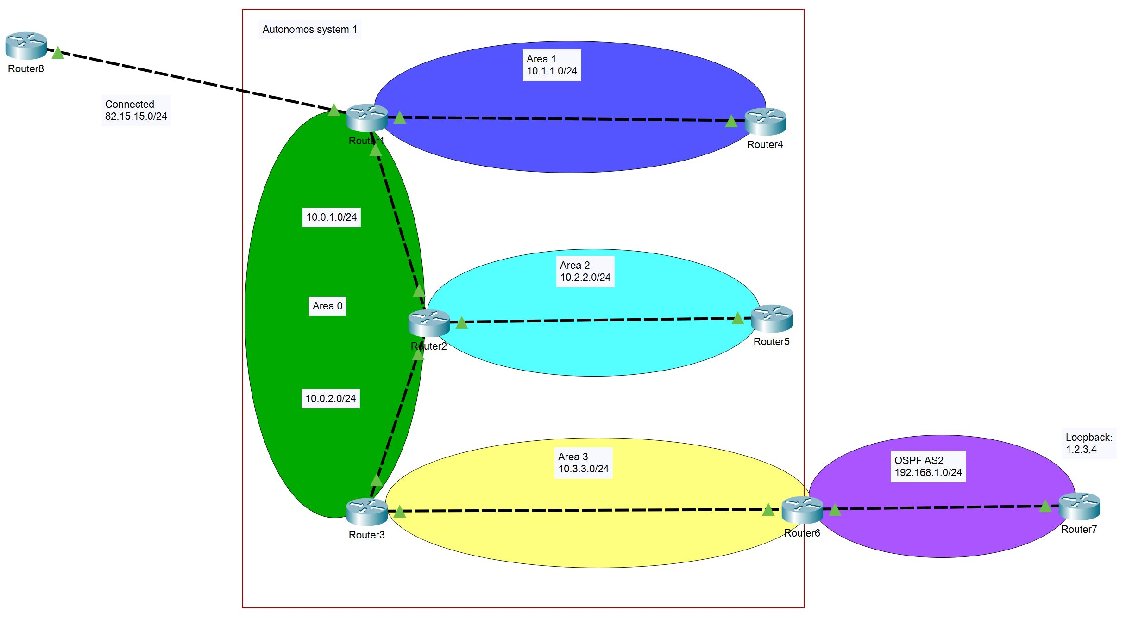
Common area types and LSAs
Stub Area
No LSA type 4
No LSA type 5
Totally Stubby Area
No LSA type 3
No LSA type 4
No LSA type 5
NSSA Area
Uses LSA type 7
No LSA type 5

Slide 44
Access Control Lists – overview (3)

Slide 45

What is an ACL?
ACL: Access Control List
ACL is a list of rules – each of them is permit or deny
Created and applied on a Layer 3 device
A device with applied ACL acts like a firewall (almost)

Slide 46
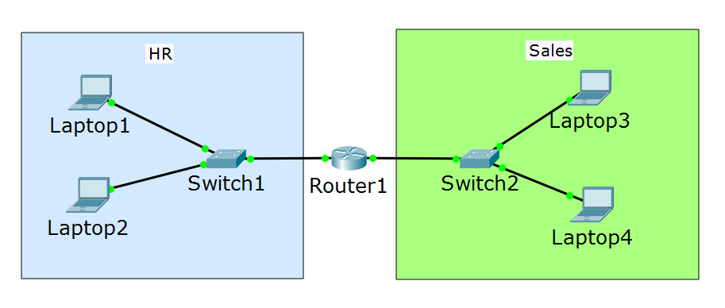
Why to implement ACLs?
ACLs filter the network traffic
Better security
Can increase the overall network performance
ACLs may just select traffic for other reasons:
Applying QoS
NAT
Traffic mirroring

Slide 47
ACL types
Standard ACLs – can filter only the source IP address of a packet
Extended ACLs – can filter based on:
Source and/or destination IP address
Source and/or port TCP/UDP number
IP protocol (DNS, FTP, HTTP, etc.)
Ethernet frame header ACLs
Filtering based on source or destination MAC address
Not very common

Slide 48
ACL process order
Test the packet against criteria in 1st rule
Is there a match?
Yes
Perform action: permit OR deny
End
No
Test the packet against criteria in 2nd rule
Is there a match?
Yes
Perform action: permit OR deny
End
No
Test the packet against criteria in Nth rule
Is there a match?
Yes
Perform action: permit OR deny
End
No
Packet is denied
End

Slide 49
Access Control Lists – creating (3)

Slide 50
Standard ACLs configuration
ip access-list standard [<1-99> or name]
[permit or deny] network [wildcard mask ] or any or host
Examples:
ip access-list standard test_standard
permit 192.168.1.0 0.0.0.255 (the whole 192.168.1.X network)
deny host 10.1.1.1 (only the host with IP 10.1.1.1 matches here)
deny host 172.16.34.15 (the exact 172.16.34.15 host)
permit any (anything else which did not match before)
deny any (do not forget the implicit deny at the end of each ACL!)

Slide 51
Extended ACLs configuration
ip access-list extended [<100-199> or name]
[permit or deny] protocol [source] network or any or host [destination] network or any or host
Examples:
ip access-list extended test_extended
deny ip host 10.1.1.1 host 20.2.2.2
permit tcp 10.12.12.0 0.0.0.255 host 20.2.2.2 eq www
deny icmp any 172.16.0.0 0.0.255.255 echo
deny ip any any (do not forget the implicit deny at the end of each ACL)

Slide 52
Access Control Lists – assigning (3)

Slide 53
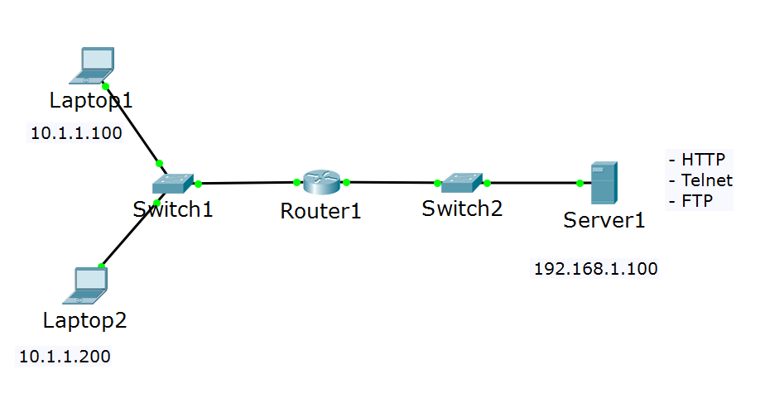
Assigning ACLs - inbound
ACL is assigned for inbound traffic

Slide 54
Assigning ACLs - outbound
ACL is assigned for outbound traffic

Slide 55
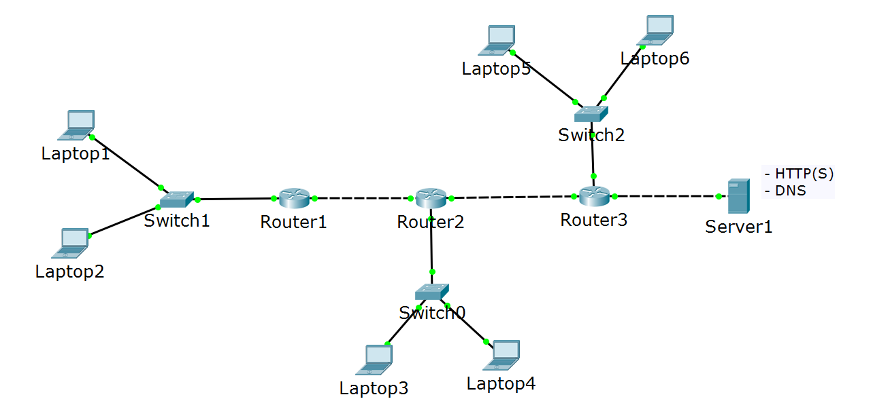
Assigning ACLs – best practice for standard ACLs
deny HTTP only from Laptop1

Slide 56
Assigning ACLs – best practice for extended ACLs
deny HTTP only from Laptop1

Slide 57
Network Address Translation (3)

Slide 58
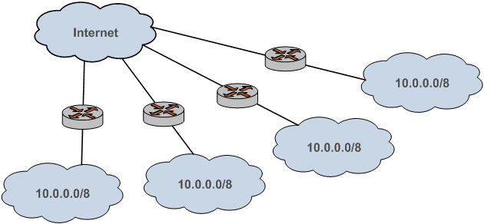
Why NAT?
Primary idea – to solve the “not enough IPv4 addresses” problem
There are only ≈ 4 billion addresses (in IPv4) – quite insufficient for the huge number of Internet users
NAT allows the private addresses to be reused since they are not routed in Internet

Slide 59
Types of NAT
Source NAT
Destination NAT
Bidirectional NAT

Slide 60
NAT terminology
Inside local address - assigned to a host on the inside network, typically private IP address
Inside global address - a public, legitimate IP address that represents one or more inside local addresses to the outside world
Outside local address - IP address of an outside host as it appears to the inside network (can be private address)
Outside global address - public address assigned to a host on the outside network

Slide 61
NAT vs PAT
PAT: Port Address Translation
In NAT, 1 private address is translated to 1 public address
In PAT, multiple private addresses are translated to 1 public
PAT creates a table which matches: Inside local:source_port -> Inside global:unique_source_port
This way PAT knows to which exact internal host should forward the returning traffic

Slide 62
Domain Name System (4)

Slide 63
DNS structure
DNS is hierarchical and distributed system
At the top there is the root domain or “.”
One level below are the TLD (top level domains, i.e. “.com”)
One level below are the second level domains, i.e. “yahoo”
Possible third level domains, etc.
DNS Zone – part of the DNS namespace, managed by specific organization

Slide 64
Resource records (in a DNS zone)
Common resource records and their purposes:
A record: a name which points to a IPv4 address
AAAA record: a name which points to a IPv6 address
CNAME record (alias): a name which points to another name (Canonical Name)
MX record: shows who is the mail server for that domain (Mail EXchanger)
TXT record: text entry, usually used for domain verification and anti-spam (TeXT)
NS record: shows which are the name servers for the zone (Name Server)
SOA record: contains administrative information about the zone (Start Of Authority)

Slide 65
Windows client local DNS cache
Resolved DNS queries stay in the local cache for a time period determined by the zone TTL value on the server
The hosts file
Alternative name resolution mechanism
Usually located in %systemroot%\system32\drivers\etc folder
Not distributed and scalable but can serve as a backup DNS method
It has higher priority than DNS resolution
The content of the hosts file is constantly copied in the DNS cache

Slide 66
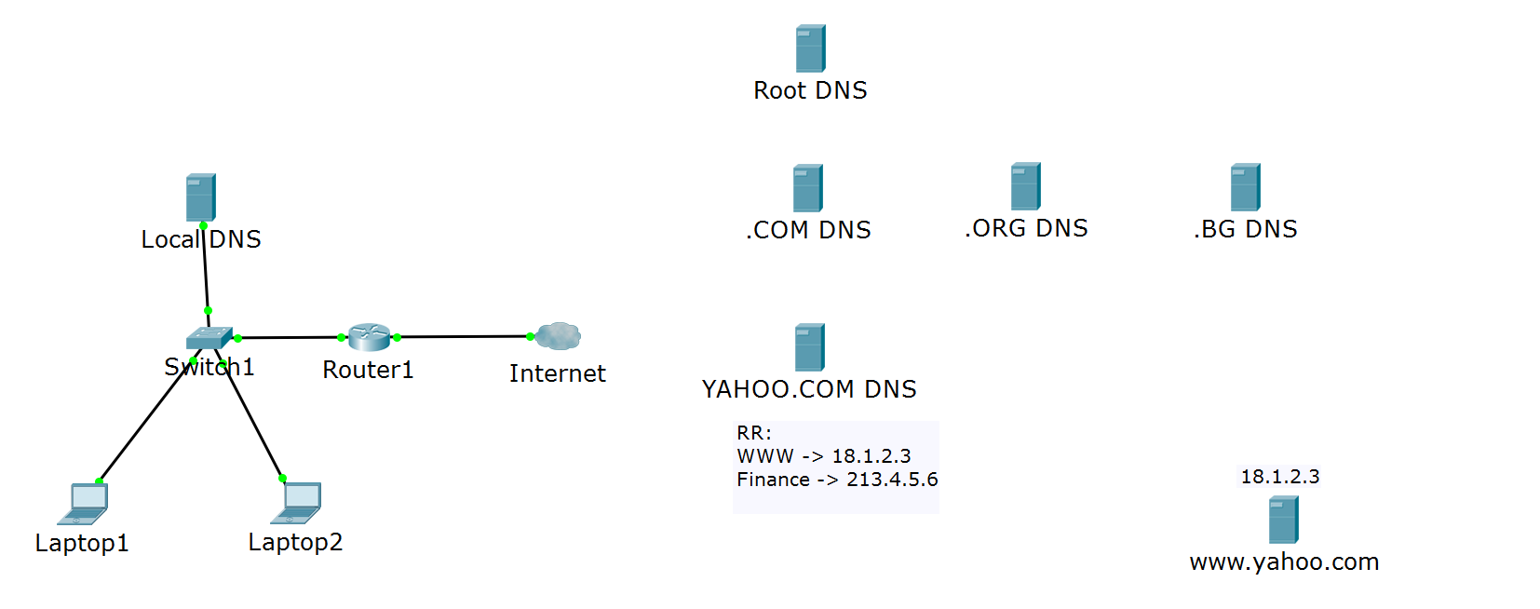


DNS query process
Where is www.yahoo.com?
I can only tell you where is .COM
Where is www.yahoo.com?
I can tell you only where is YAHOO.COM
It is at 18.1.2.3!
Where is www.yahoo.com?
Where is www.yahoo.com?
It is at 18.1.2.3!
https://www.yahoo.com

Slide 67
The NSLOOKUP command
To check a DNS resolution, one can use ping or nslookup
ping - intuitive to use but can have older and inaccurate info the purpose of ping is not to troubleshoot DNS
nslookup - useful tool designed for troubleshooting DNS
Demo: how to use nslookup on Windows

Slide 68
IPv6 (4)

Slide 69
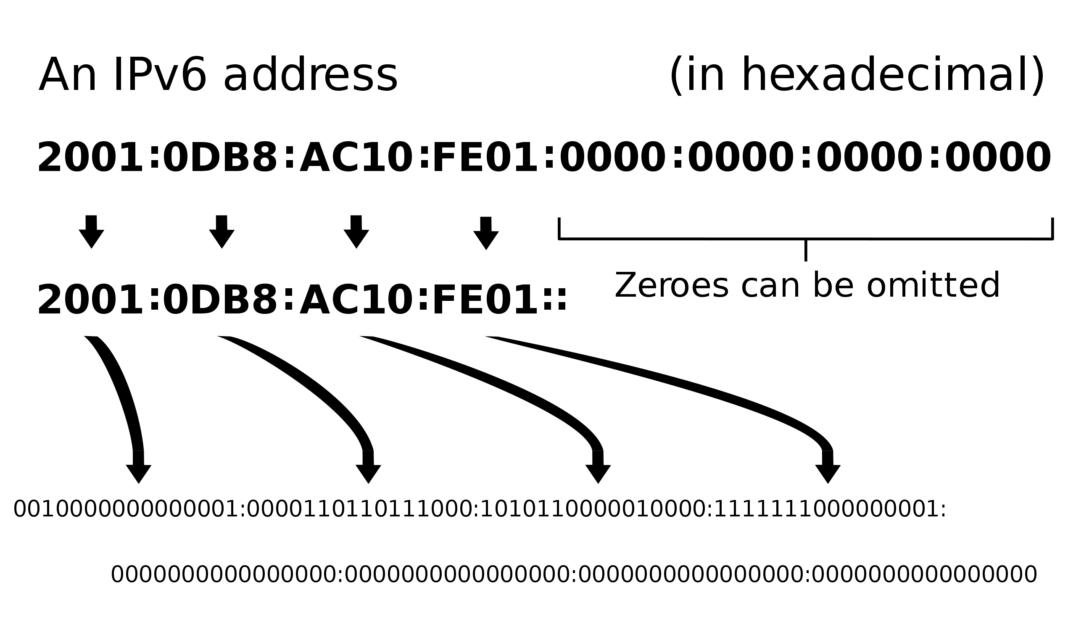
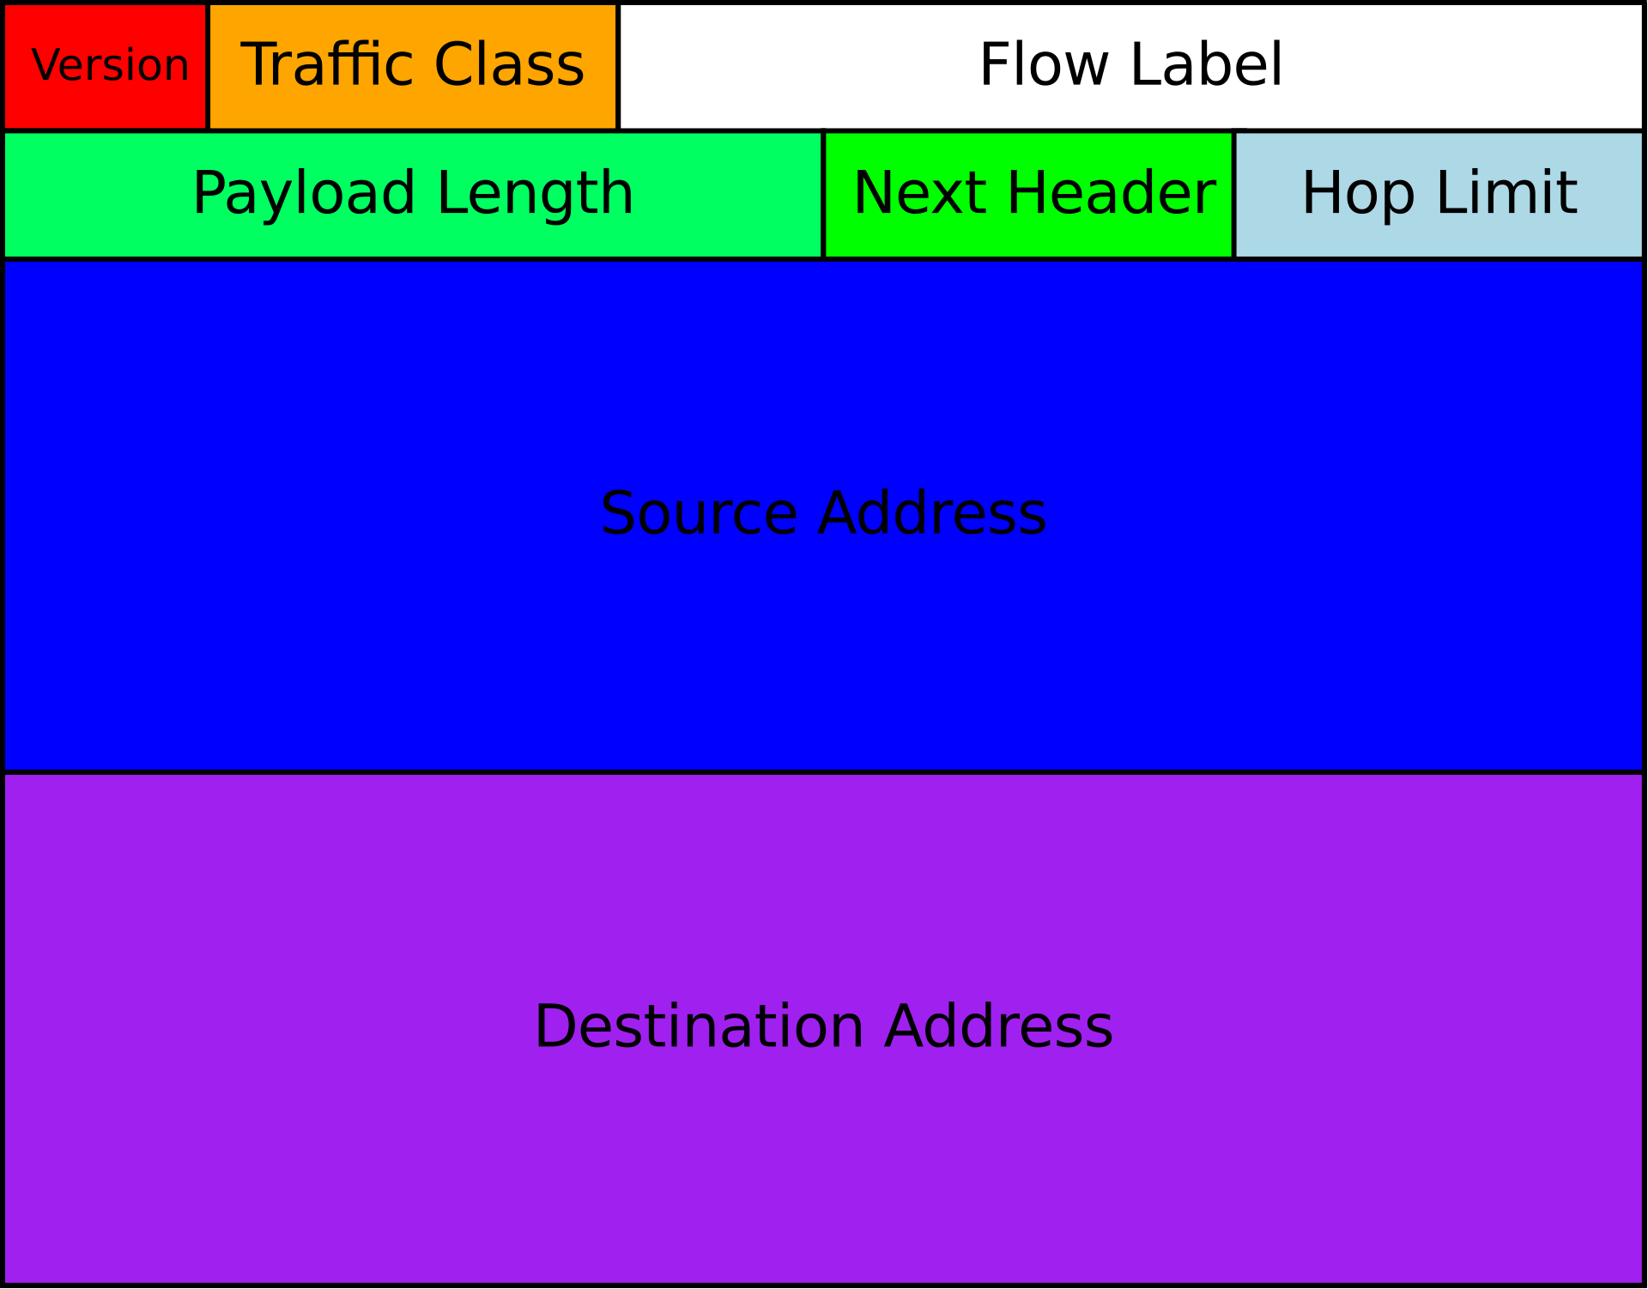
IPv6 introduction
Larger address space (128 bits rather than 32) or 2¹²⁸
Simplified header format
Improved quality of service and security

Slide 70
IPv6 address format
IPv6 address is represented as eight groups of four hexadecimal digits
Example:
2001:0db8:0000:0000:0000:ff00:0042:8132
Each of this groups has 16 bits and is separated from the others with “:”

Slide 71
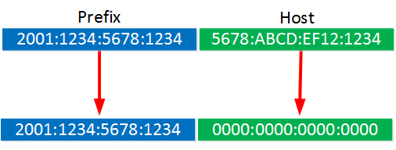
IPv6 prefixes
2001:1234:5678:1234:0000:0000:0000:0000/64
2001:1234:5678:1234::/64

Slide 72
IPv6 address types
Unicast - a packet is delivered to one interface
Multicast - a packet is delivered to multiple interfaces
Anycast - a packet is delivered to the nearest of multiple interfaces (as defined by the routing protocols in use)
*no more Broadcast in IPv6

Slide 73
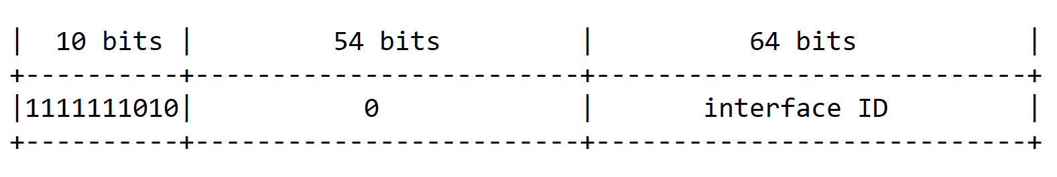
IPv6 scopes
Link-local (similar to APIPA in IPv4)
Prefix is FE80::/64
Global (similar to IPv4 public addresses)
Typical prefix is 2000::/3
…or FE80::/10?
::1/128 - the loopback address is a unicast localhost address

Slide 74
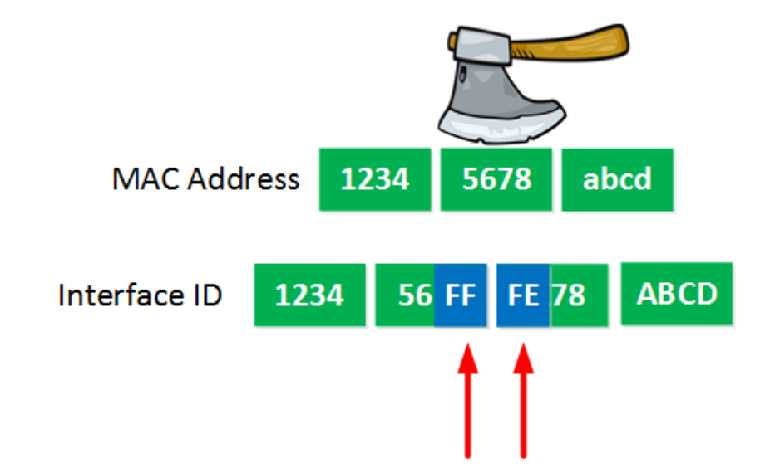
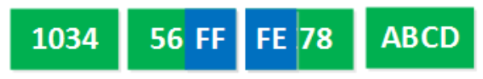
IPv6 EUI-64 bit address
How the IPv6 EUI-64 address is automatically configured:
Split the MAC address of the interface into two pieces
Insert FFEE between the two pieces (to achieve 64 bits)
Invert the 7th bit of the interface ID

Slide 75
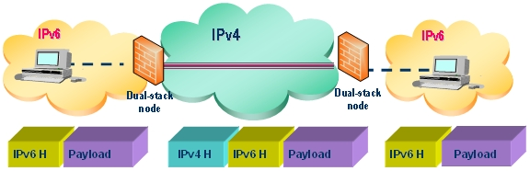
IPv6 tunneling
Encapsulates IPv6 packets in IPv4 packets for delivery across an IPv4 infrastructure
Different methods exist – 6to4, 6rd, Teredo, ISATAP, etc.

Slide 76
IPv6 SLAAC
SLAAC = StateLess Address Auto Configuration
Designed to be fast and easy alternative to DHCPv6
IPv6 Neighbor Discovery Protocol (NDP) is like ARP in IPv4
With SLAAC and NDP, nodes on the network can easily autoconfigure IPv6 address from the correct subnet/prefix
The problem: with SLAAC there is no assignment for DNS
SLAAC and DHCPv6 can be used together:
the M flag (Managed) specifies if DHCPv6 is needed for IPv6 address
the O flag (Other) specifies if DHCPv6 is needed for DNS information

Slide 77
Authentication with 802.1X (5)

Slide 78
AAA
AAA: Authentication, Authorization and Accounting
Authentication – “Who are you? Prove it!”
Authorization – “This is where you have access and where you do not”
Accounting – “I am recording all (un)successful login attempts”
Often a single server plays the three roles but can be multiple servers as well

Slide 79
802.1X
IEEE 802.1X is an IEEE Standard for Port-based Network Access Control (PNAC)
Part of the IEEE 802.1 group of networking protocols
Provides authentication mechanism to devices asking to attach to a LAN or a WLAN
Uses Extensible Authentication Protocol (EAP) over LAN – known as EAPOL

Slide 80
The participants in 802.1X
Supplicant - the end device requesting access
Authenticator – usually a switch or AP which is to provide access
Authentication Server - the device which makes the decision (grant/deny access). Usually RADIUS server

Slide 81
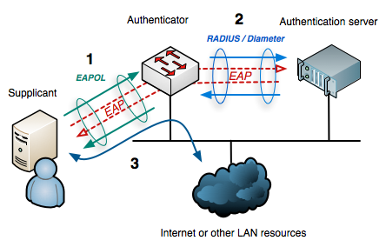
802.1X

Slide 82
802.1X and EAP
802.1x uses EAP to facilitate the communications between the participants
Common EAP authentication types:
EAP-MD5 - minimal security, one-way authentication
EAP-TLS - mutual authentication, secure but no very easy to adopt
EAP-TTLS - mutual authentication (optional client certificate)
EAP-PEAP - most popular method, has an “outer” and “inner” methods, developed by Cisco, Microsoft and RSA Security

Slide 83
Wireless networking concepts (5)

Slide 84
802.11 standards
IEEE Standard | 802.11b | 802.11a | 802.11g | 802.11n | 802.11ac | 802.11ax
Friendly name | WiFi 1 | WiFi 2 | WiFi 3 | WiFi 4 | WiFi 5 | WiFi 6
Year adopted | 1999 | 1999 | 2003 | 2009 | 2014 | 2019
Frequency | 2.4 Ghz | 5 Ghz | 2.4 Ghz | 2.4/5 Ghz | 5 Ghz | 2.4/5 Ghz
Max data rate | 11 Mbps | 54 Mbps | 54 Mbps | 450 Mbps | 1.7 Gbps | 2.4 Gbps
Typical range indoors* | 35 m | 35 m | 38 m | 70 m | 35 m | -
Typical range outdoors* | 140 m | 120 m | 140 m | 250 m | 250 m | 250 m

Slide 85
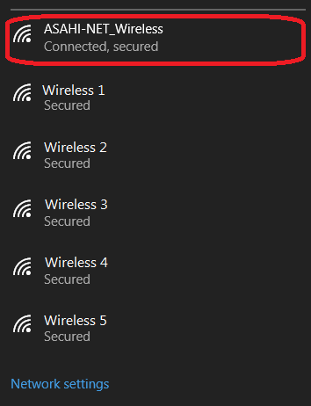
SSID
SSID: Service Set Identifier
This is the name of the wireless network (not the Access Point name)
It is up to 32 characters in length
A single AP can broadcast multiple SSIDs
Should you hide your SSID?

Slide 86
Wireless security
Hiding the SSID (“not the best” security)
MAC ID filtering
Static client IP addressing
802.11 security (next slide)

Slide 87
802.11 security
WEP - very weak, deprecated
WPA - better than WEP, still risky
WPA2 - the de facto standard
WPA2 (TKIP) - risky
WPA2 (AES)
WPA2-PSK vs WPA2-Enterprise (which uses EAP)
WPA3 - improved general Wi-Fi encryption
WPA3 - personal (uses Simultaneous Authentication of Equals (SAE) vs PSK)
WPA3 - enterprise (targets large-scale Wi-Fi with optional 192-bit security)
Better security

Slide 88
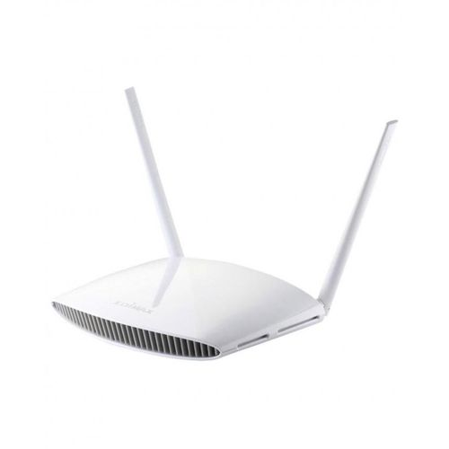
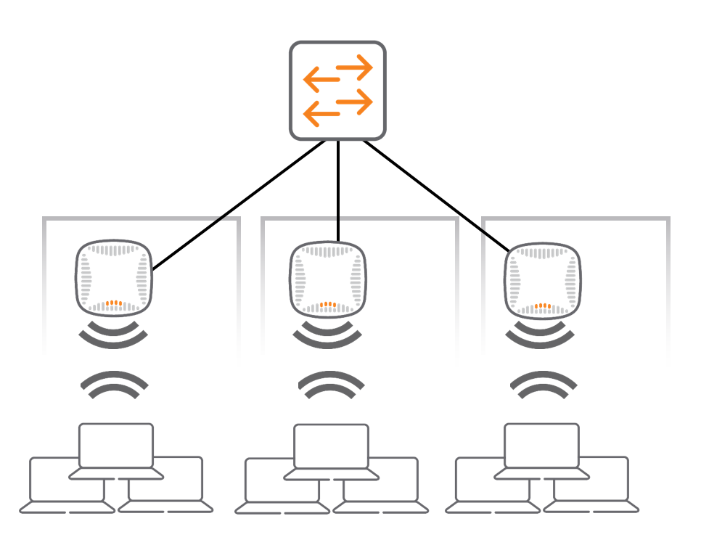
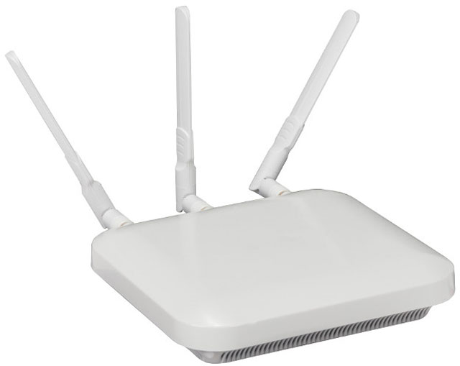
Wireless devices management
APs in standalone mode
APs controlled by a controller

Slide 89
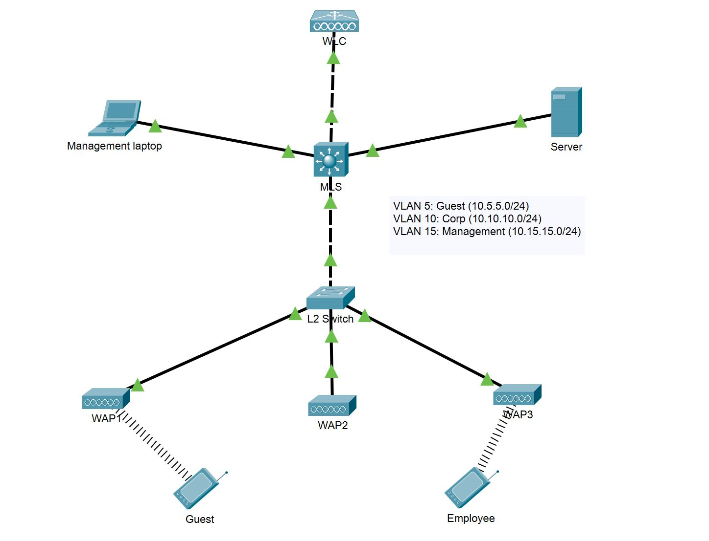
Wireless Lan Controller lab

Slide 90
Quality of Service (6)

Slide 91
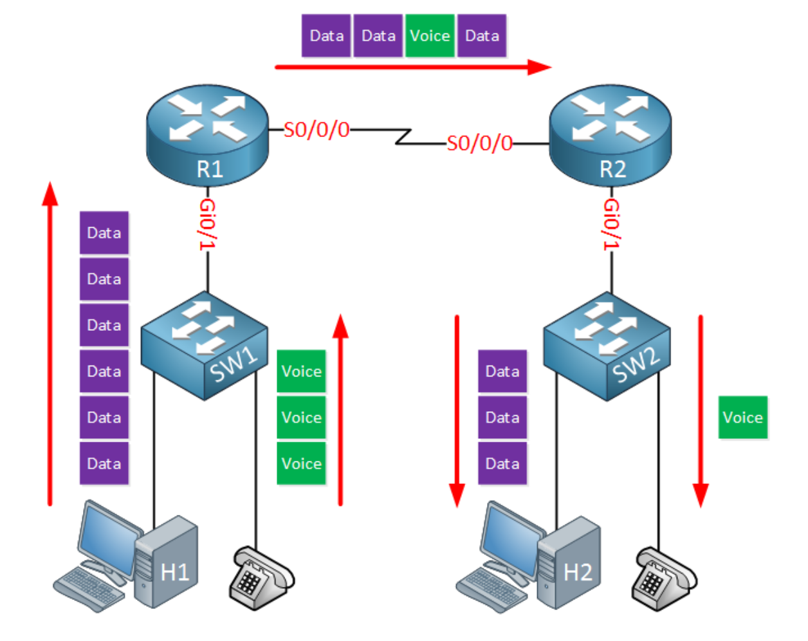
What is QoS?
Network devices does NOT care about the type of traffic they need to forward:
Switches use destination MAC
Routers use routing tables
The logic in forwarding is simply FIFO (First In First Out)
QoS is a way to prioritize

Slide 92
Characteristics of network traffic
Bandwidth - the speed of the link
Delay - the time it takes for a packet to get from the source to the destination (a.k.a. one-way delay)
Jitter - the variation of the delay for each packet
Loss - the amount of the lost data

Slide 93
QoS tools
Classification and marking
Queuing
Policing and shaping
Congestion avoidance

Slide 94
Classification and marking
For each packet to have different treatment, we have to first identify and mark them
There are different methods to classify a packet:
Header inspection - looks for MAC, IP, port numbers
Payload inspection - looks inside the packet, making deep packet inspection. On Cisco routers, this is done with NBAR (Network-Based Application Recognition)

Slide 95
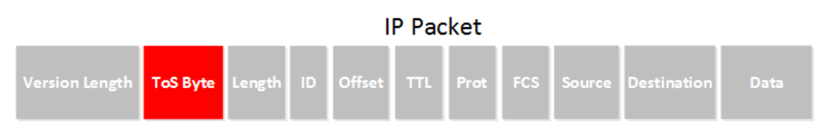
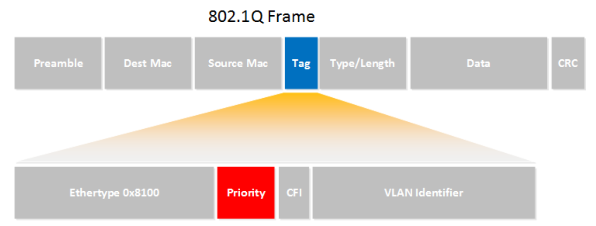
Classification and marking (2)
Once classified, we need to mark the packet or frame
For L3 packets, we modify the ToS field:
For L2 frames, we modify the Priority field (for trunks only):

Slide 96
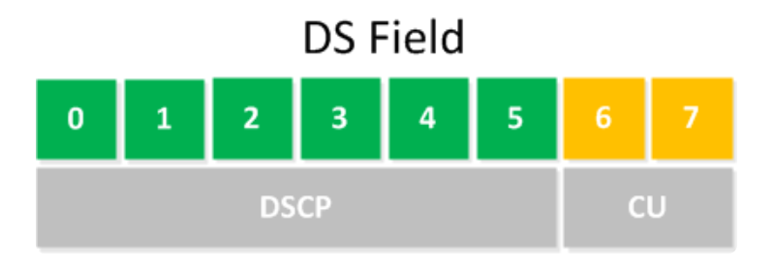
Differentiated Services
In 1998, the ToS filed gets a new name: DS field
The first 6 bits set a code point which affects the Per Hop Behavior
DSCP: Differentiated Services Code Point
DSCP PHB (Per Hop Behavior) options:
Default PHB
Class-Selector PHB
Assured Forwarding PHB
Expedited Forwarding PHB

Slide 97
QoS tools
Classification and marking
Queuing
Policing and shaping
Congestion avoidance

Slide 98
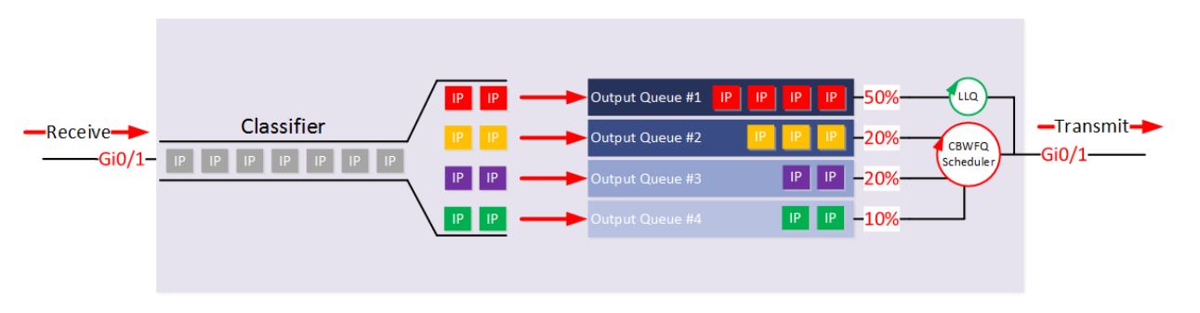
Queuing/Congestion management
Voice traffic can be attached to LLQ (Low Latency Queue) in order to be sent immediately
It is important to limit the LLQ to ensure the other queues get served as well, otherwise que starvation will occur

Slide 99
QoS tools
Classification and marking
Queuing
Policing and shaping
Congestion avoidance

Slide 100
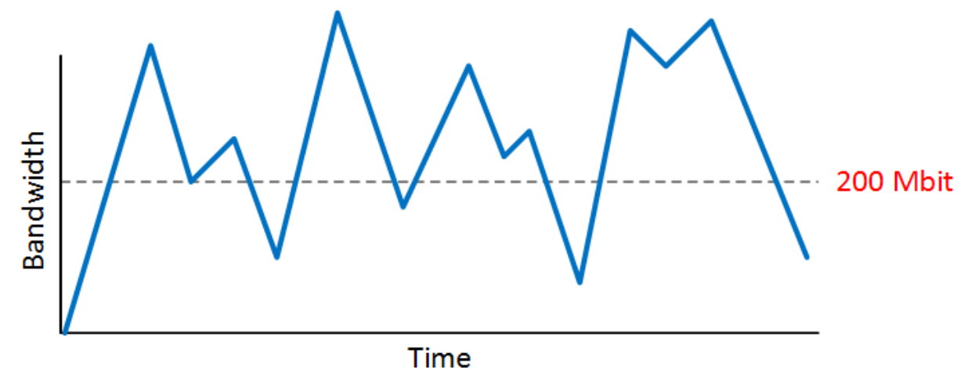
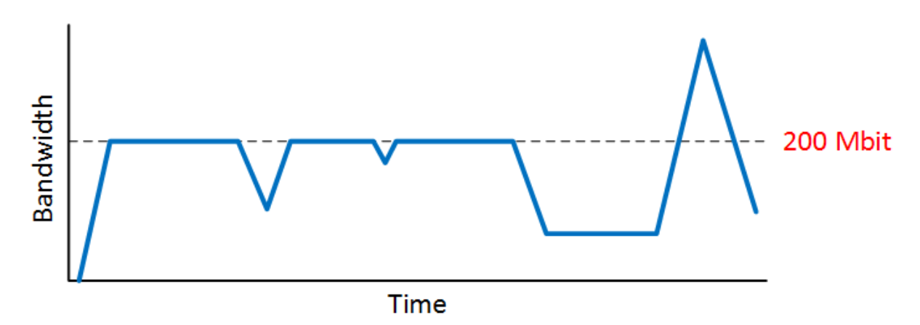
Policing
Policers discard traffic in order to meet the CIR (Committed Information Rate)
Without policing
With policing

Slide 101
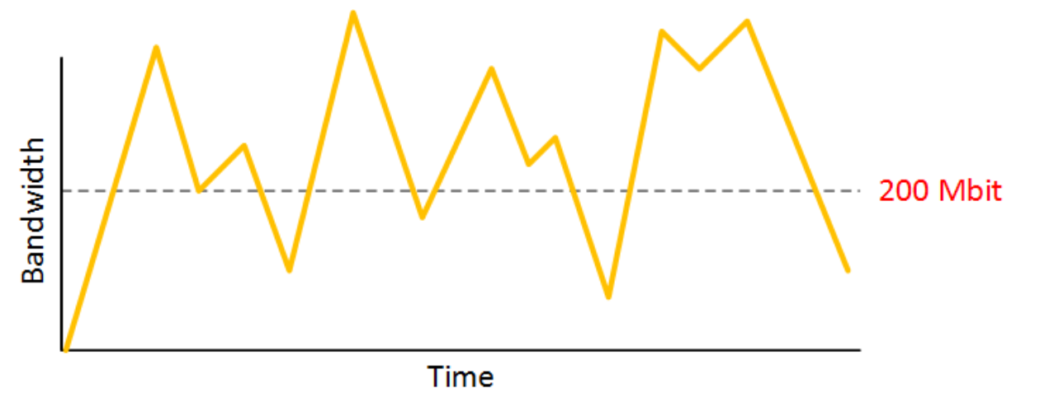
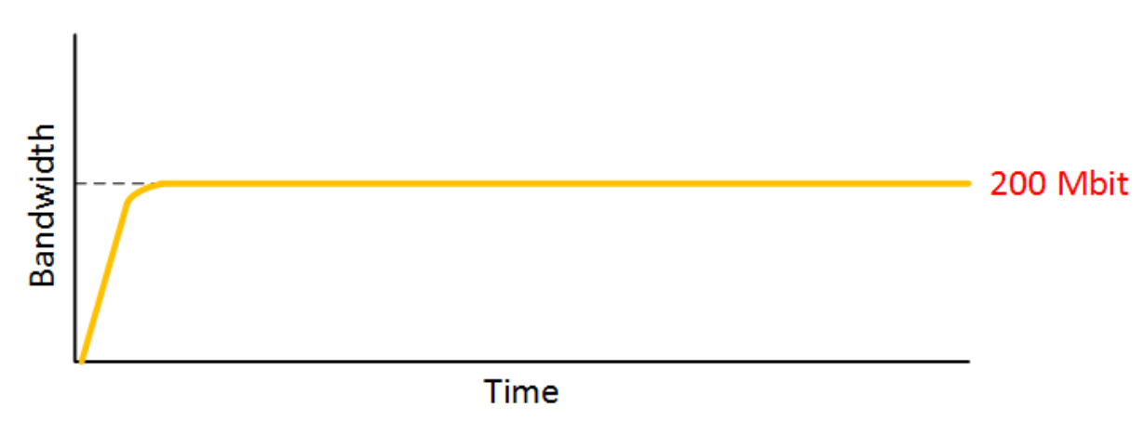
Shaping
Shapers hold packets in a queue, causing delay
This prevents our traffic from getting dropped at the other end
Before
After

Slide 102
QoS tools
Classification and marking
Queuing
Shaping and policing
Congestion avoidance

Slide 103
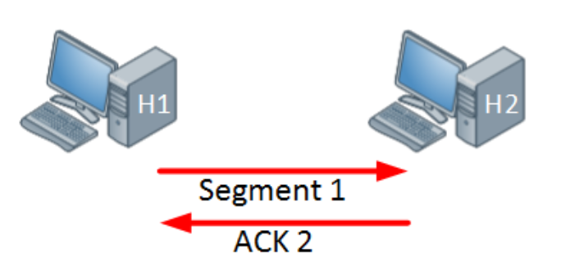
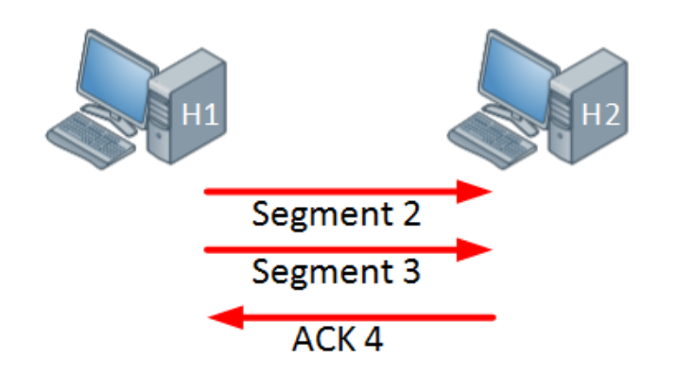
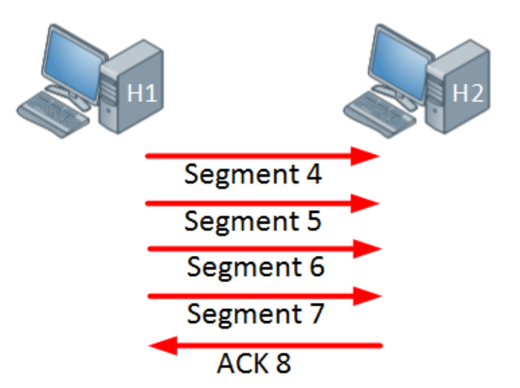
Congestion avoidance
Remember the TCP windowing?
Tail drop – when congestion occurs, all packets at the end are dropped
This causes TCP global synchronization
With congestion avoidance mechanisms, once the output queue is at certain level, it will drop TCP segments in order to reduce the window size
Example: WRED (Weighted Random Early Detection)

Slide 104
Port mirroring (6)

Slide 105
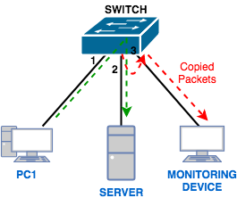
What is port mirroring?
Also called port monitor or SPAN (Switch Port Analyzer) in Cisco
Lets you copy all traffic from a source port or source VLAN to a destination interface

Slide 106
Why port mirroring?
SPAN can be useful for a number of reasons:
If you want to use Wireshark to capture a communication, you need to sniff
To redirect all traffic from a VLAN to an IDS/IPS
Redirect all VoIP calls from a VLAN so you can record the calls

Slide 107


Types of SPAN
Local SPAN
Remote SPAN (RSPAN)

Slide 108
Network management systems (7)

Slide 109

What is a network management system?
A central “hub” to monitor and manage multiple devices
Advantages:
Easy to manage your network
Saves time
Cost effective
Decreases downtime
…more?

Slide 110

SNMP components
Agent
Management station (NMS)
SNMP messages
Management information base (MIB)

Slide 111
SNMP message types
Get - Read only
Set - Read/Write
Trap - generated by the agent

Slide 112

SNMP MIB
MIB: Management Information Base
Collection of information organized hierarchically
Each entry in MIB is addressed through OID (object ID)
MIB structure must be known by the NMS and the agents

Slide 113
SNMP versions
SNMP v1
poor security
not very good performance
SNMP v2c
poor security
better performance
SNMP v3
Secure and with good performance
More difficult to configure

Slide 114
Hyper-V and virtual networks
In Hyper-V, when you create a new network, you create a new virtual switch
You can create different types of networking (switches), depending on your needs:
Private
Internal
External

Slide 115





HPE IMC
(WS 2019)
DNS Server
(WS 2019)
VSR1
VSR2
GNS3
10.1.1.2
10.1.1.3
10.1.1.1
10.1.1.5
10.1.1.6 and 10.1.1.7
Windows 10 Hyper-V host with VMware Player
Windows 10 Hyper-V host with VMware Player
10.1.1.4
10.1.1.100
10.1.1.200

Slide 116
Software Defined Networking (8)

Slide 117
The old (current) way of doing networking
Networking vendors sell proprietary hardware
Hardware can be different, but devices talk to each other using protocols
These protocols are built in the OS/image in each device
We need to separately configure the logic for each “box” by using:
Command Line Interface (CLI)
Some kind of Network Management System (NMS)

Slide 118
How network devices make forwarding decisions
Switches and routers should decide where to send a particular packet so each device may need to consider, build or change:
MAC address tables
Routing tables
Use ARP to find the destination MAC
Decrease the TTL of each packet
Different planes are responsible for the different tasks: control plane, data plane and management plane

Slide 119
Devices and planes
Control plane (the brain). Responsible for:
Building ARP tables
Building routing tables
Running STP to avoid loops
Data plane (the muscles). Responsible for:
Encapsulation/decapsulation
Adding or removing headers (802.1Q for example)
Replace source/destination address (if there is NAT)
Management plane - used for accessing and managing the devices. Examples - Telnet, SSH

Slide 120

What is SDN?
SDN - Software Defined Networking
SDN uses a centralized control plane - SDN controller

Slide 121

SDN controller interfaces
Northbound Interface (NBI)
Used to access and program the controller
Can have GUI, CLI and API
You can write scripts for automation
Southbound Interface (SBI)
The controller’s communication with the “dumb” devices
It is a software interface, often API

Slide 122

SDN northbound interface
The interface allows multiple applications to access the controller:
GUI
Java/Python or other scripts
3rd party apps
REST API (next slide) is typically used

Slide 123
SDN southbound interface
This is the controller’s communication with the “dumb” hardware
It specifies a software (not a physical) interface
Some popular southbound interfaces:
OpenFlow
Cisco OpFlex
CLI (in the APIC-EM controller)

Slide 124

SDN OpenFlow

Slide 125

Mininet and miniedit (2)

Slide 126
Cloud networking with Microsoft Azure (9)

Slide 127

VNets and subnets
A virtual network can be segmented into one or more subnets
Subnets provide logical divisions within your network
Benefits of subnetting a virtual network include security and performance
Each subnet must have a unique address range - cannot overlap with other subnets in the virtual network in the subscription

Slide 128

Network Security Groups (NSG)
You can limit network traffic to resources in a virtual network
An NSG contains a list of security rules that allow or deny inbound or outbound network traffic
An NSG can be associated to a subnet or a network interface
Similar to Access Control Lists discussed before

Slide 129
Virtual network peering
VNet peering connects two Azure virtual networks
Peered networks use the Azure backbone for privacy and isolation
Easy to setup, seamless data transfer and great performance
VNet1--Sofia (10.1.0.0/16)
Peering
VNet2--Paris (10.2.0.0/16)
Subnet1: 10.1.1.0/24
Subnet1: 10.2.1.0/24
Subnet2: 10.1.2.0/24

Slide 130
VPN gateway
Used to send encrypted traffic between Azure and on-premise
Can also create tunnels between Azure virtual networks
Is able to accept multiple connections
Each VNet can have only one VPN gateway
Special VNet subnet is required before creating the VPN gateway
Different connection topology diagrams are supported – site-to-site, multi-site, point-to-site, VNet-to-VNet

Slide 131

Azure DNS zones
Azure offers a DNS service where you can host your DNS zones
You do not have to own the domain to create a DNS zone with that domain name in Azure
But…if you want the records in your domain to be resolved by everyone in Internet, then:
You must own the domain
You must change the name servers in your domain register to point to your Azure DNS zone

Slide 132

Private DNS zones
Private DNS zones provide name resolution in virtual networks without the need to add a custom DNS solution
Not accessible over the Internet
Capabilities and benefits:
All common DNS records types are supported
Hostname resolution between virtual networks
Automatic hostname record management
Available in all Azure regions
When you create a Private DNS zone, you have to link it with one or more virtual networks

Slide 133


System and user-defined routes (UDR)
Before the UDR, system routes connects VMs from each subnet directly
After a UDR is created, the routing table for Subnet 1 is updated so the traffic goes via the Virtual appliance in Subnet 2
VNet1:10.1.0.0/16
Subnet 1
10.1.1.0/24
Subnet 3
10.1.3.0/24
Subnet 2
10.1.2.0/24
NVA

Slide 134



Demonstration
VNet1--Sofia (10.1.0.0/16)
Subnet 1: 10.1.1.0/24
Peering
VNet2--Paris (10.2.0.0/16)
Sofia-HQ
Subnet 2: 10.1.2.0/24
Subnet 1: 10.2.1.0/24
Sofia-Branch
VNGateway1
Paris
GW Subnet: 10.1.0.0/24
P2S VPN
VNet3--Tokyo (10.3.0.0/16)
IPSec VPN
Subnet 1: 10.3.1.0/24
Tokyo
GW Subnet: 10.3.0.0/24
VNGateway2

Slide 135
Knowledge check

Slide 136
Question 1
What is an advantage of MSTP over PVST+?
It uses more BPDUs and therefore calculates the topology faster
It is easier to configure than PVST+
It uses less BPDUs and therefore creates less overhead
It is VLAN aware

Slide 137
Question 2
What is an advantage of PVST+ over MSTP?
It is VLAN aware and triggers STP calculation for each VLAN individually
It is more difficult to configure than MSTP
It uses less BPDUs and therefore creates less overhead
It is VLAN unaware which simplifies the creation of the VLANs across the network

Slide 138
Question 3
Which of the following in terms of link aggregation is false?
The physical interfaces which participate in a link aggregation group should have the same speed and duplex settings
There is static and dynamic LACP
Link aggregation load balances on a per-packet basis and ensures equally distributed traffic across the physical links
Link aggregation benefits include higher bandwidth and better redundancy

Slide 139
Question 4
Which of the following in terms of IRF is wrong?
You can only have Ring or Daisy chain topologies
The member ID of each device may be the same, but the priorities must be different
An IRF stack must consist of Comware devices only
The priorities of each device may be the same, but the member IDs must be different

Slide 140
Question 5
What is the difference between NAT and PAT? (select multiple)
NAT translates one private to one public IP address
NAT translates multiple private to one public IP address
PAT translates one private to multiple public IP address
PAT translates multiple private to one public IP address

Slide 141
Question 6
Which of the following determines how long a DNS entry will stay in the client’s cache?
The operating system of the client
The TTL value
Your ISP
The operating system of the DNS server

Slide 142
Question 7
What is the best way to secure a wireless network?
Make the SSID hidden, so the clients must know it in order to connect
Implement MAC ID filtering to allow only known devices to the network
Disable the DHCP server on your wireless router
Implement WPA3/WPA2

Slide 143
Question 8
Which are the main components of an SNMP system?
Agent, messages, network management system and MIB
Get, set and trap
Community strings
IMC, authentication protocol and SNMP enabled devices

Slide 144
Question 9
Which of the following in terms of SDN is false?
It uses Northbound interface and Southbound interface
It has a decentralized control plane
You may use REST API to communicate with the controller
OpenFlow is a typical SDN protocol

Slide 145
Question 10
Two possible options to connect between two VNets in Azure are:
Point-to-site VPN and ExpressRoute
Virtual network peering and VPN
System routes and user-defined routes (UDR)
Using NSG and NAT

Slide 147












SoftUni Diamond Partners

Slide 148


Educational Partners

Slide 149
Trainings @ Software University (SoftUni)
Software University – High-Quality Education, Profession and Job for Software Developers
softuni.bg, about.softuni.bg
Software University Foundation
softuni.foundation
Software University @ Facebook
facebook.com/SoftwareUniversity
Software University Forums
forum.softuni.bg
Notes:
149

